Slide 1




vNIDS: Towards Elastic Security with Safe and Efficient Virtualization of Network Intrusion Detection Systems
Hongda Li¹, Hongxin Hu¹, Guofei Gu²,
Gail-Joon Ahn³, and Fuqiang Zhang¹
¹
²
³
³
CCS 2018

Slide 2



Traditional NIDSes

Slide 3
Traditional NIDSes
Multi-thread
Clustered
Multi-thread
GPU Acceleration
Multi-thread
GPU Acceleration

Slide 4
Traditional NIDSes
Multi-thread
Clustered
Address scalability issue:
Multi-core/thread
Cluster
Multi-thread
GPU Acceleration
Limited in flexibility:
Fixed location
Constant capacity
Multi-thread
GPU Acceleration

Slide 5

Requirement 1: Virtualized Environments
Blur & Fluid Perimeters
Virtualized Network Zones
Zone₁
Zone₂
Zone₃
Service
Migration
Datacenter₂
Datacenter₁
Datacenter₃
Infrastructure

Slide 6
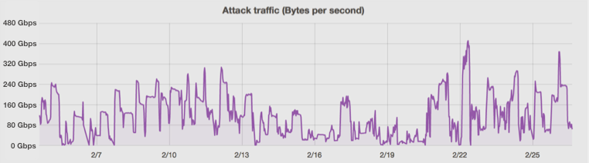
Requirement 2: Traffic Volume Variation
Expensive option:
capacity ≥ peak traffic load
DDoS attack on Feb. 2016
Gbps
400
320
240
Significant Variation
160
80
0
2/19
2/22
2/25
Time
Source: https://blog.cloudflare.com/a-winter-of-400gbps-weekend-ddos-attacks/

Slide 7


New Trends
Network Function Virtualization (NFV)
  Software instances
Software-Define Networking (SDN)
  Dynamic traffic steering
Virtualization Platform
SDN Switch
NFV
SDN
Elastic Security

Slide 8
Elastic Security
NIDS Virtualization:
flexible location & capacity
Scalable and Flexible
network security functions
Existing Work
VFW Controller
(NDSS’17)
PSI
(NDSS’17)
Bohatei
(USENIX Sec’15)

Slide 9
vNIDS enables safe and efficient NIDS virtualization
Safe Virtualization: does not miss attacks
Efficient Virtualization: provisioned optimally

Slide 10
Ch. 1: Effective Intrusion Detection
Missing Malicious Activities
Instance₁
Instance₂
SIP=10.1.1.1
SIP=10.1.1.1
SIP=10.1.1.1
SDN Switch
Scanner Detector

Slide 11
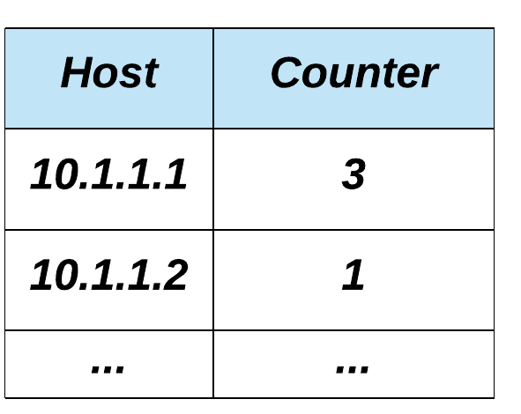
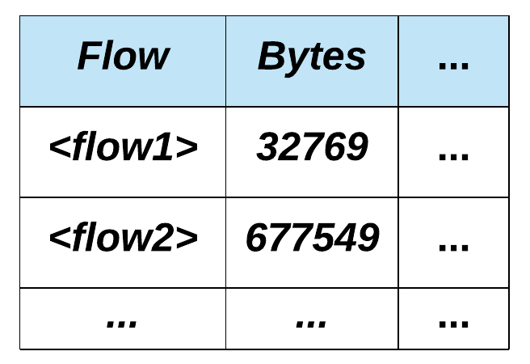
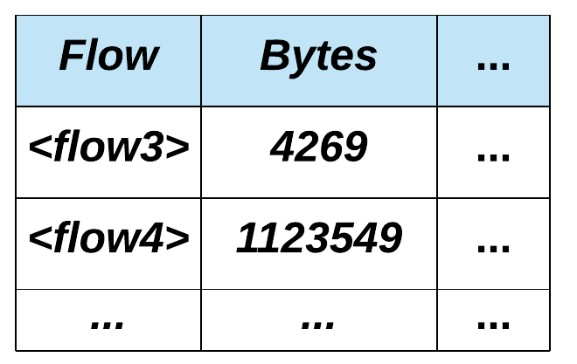
Ch. 1: Effective Intrusion Detection
Per-flow State
Multi-flow State
Shared Data Store
Instance₁
Instance₂
How to distinguish per-flow and multi-flow states?

Slide 12
Ch. 2: Non-monolithic NIDS Provisioning
Inefficient Resource Allocation
Can’t fit
3
2
Monolithic
NIDS Instance
Virtualized NIDSes:
Allocate and deallocate more frequently
Cloud

Slide 13
Ch. 2: Non-monolithic NIDS Provisioning
Inefficient Scaling
Detector₁
Detector₂
Overloaded
NIDS Engine
Detector₁
Detector₂
Monolithic
NIDS Instance
Scale slow
Over-provisioned
NIDS Engine
Detector₁
Detector₂
Virtualized NIDSes:
NIDS Engine
Scale more frequently

Slide 14

Ch. 2: Non-monolithic NIDS Provisioning
Non-monolithic Provisioning
Monolithic Provisioning
General
How to decompose?
How to enforce detection logics?
Fine-grained

Slide 15
vNIDS Architecture Overview
Detection Logic Programs
1. program analysis
vNIDS Controller
Effective Intrusion Detection
Detection State Classification
State Management
vNIDS Microservice Instances
2. detection state sharing
Shared Data Store
Shared Data Store
Shared Data Store

Slide 16
vNIDS Architecture Overview
Detection Logic Programs
4. program slicing
vNIDS Controller
Effective Intrusion Detection
Non-Monolithic NIDS Provisioning
Detection State Classification
Detection Logic Program Partitioning
State Management
Provision Control
3. microservices
vNIDS Microservice Instances
Header-based Detection Instances
Protocol Parse Instances
Payload-based Detection Instances
Shared Data Store
Shared Data Store
Shared Data Store
Header-based Detection
Microservice
Protocol Parse
Microservice
Payload-based Detection
Microservice

Slide 17
Scope of Detection States
Flow record
  Essential data structure of NFs
Lifetime
  Determines scope of detection states
“Always” freed before a flow record is freed
Dedicated to a certain flow
Not “always” freed before a flow record is freed
Must be freed by other flows

Slide 18
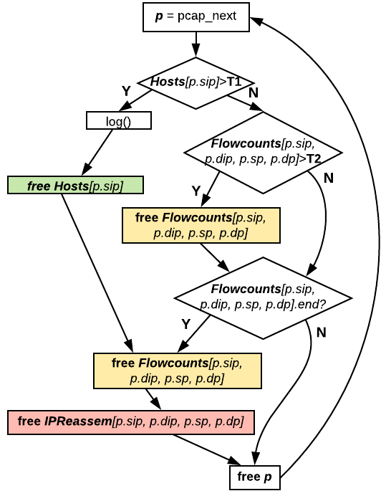
Inferring the Scope of Detection States
Compute the CFG of the detector

Slide 19
Inferring the Scope of Detection States
Compute the CFG of the detector
Compute dominator of statement T
Flow record is freed here (Statement T)

Slide 20
Inferring the Scope of Detection States
Compute the CFG of the detector
Compute dominator of statement T
Entry point
Dominator of T
Statement T

Slide 21
Inferring the Scope of Detection States
Compute the CFG of the detector
Compute dominator of statement T
Entry point
Multi-flow
detection state
Dominator of T
Statement T
Per-flow
detection state

Slide 22
Logic Structure of NIDSes
Various detection tasks
Detection Logics
Application Protocol Parsers
Payload parsing
Network Traffic
Network
Protocol Stack
Network layer processing
Monolithic NIDS

Slide 23
Types of Detection Logics
Only inspect header
Not rely on APPs
Inspect header & payload
Need APPs
Type-II
Detection Logics
Type-I
Application Protocol Parsers
Network Traffic
Network
Protocol Stack
Monolithic NIDS

Slide 24
Decomposing NIDSes
Monolithic NIDS
Type-II
Detection Logics
Type-I
Application Protocol Parsers
NIDS Decomposed as Microservices
Network
Protocol Stack
Type-I
Detection Logics
Application Protocol Parsers
Type-II
Detection Logics
Network
Protocol Stack
Network
Protocol Stack
Network
Protocol Stack
Header-based
Detection
Microservice
Protocol Parse
Microservice
Payload-based
Detection
Microservice

Slide 25
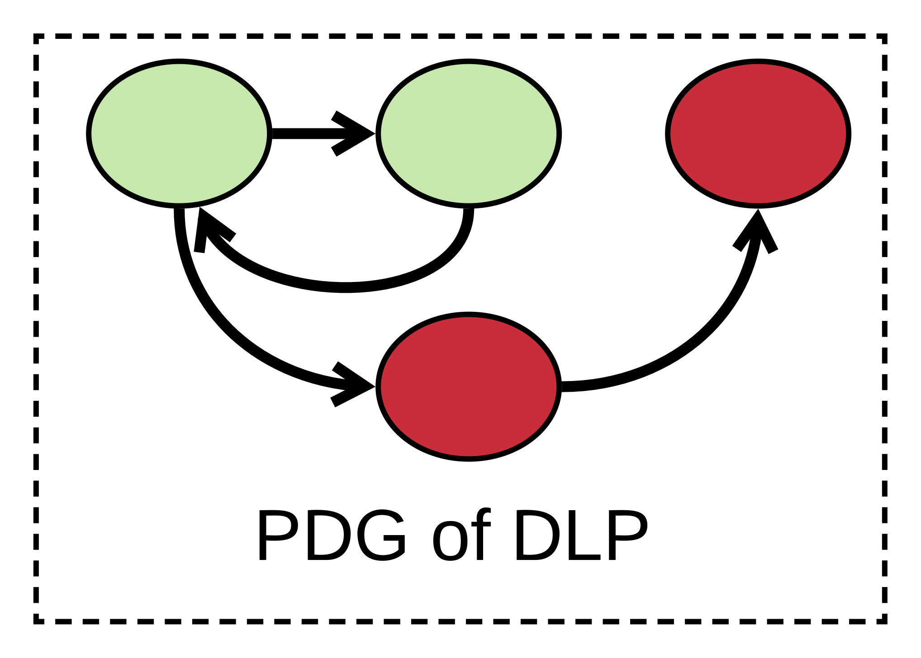
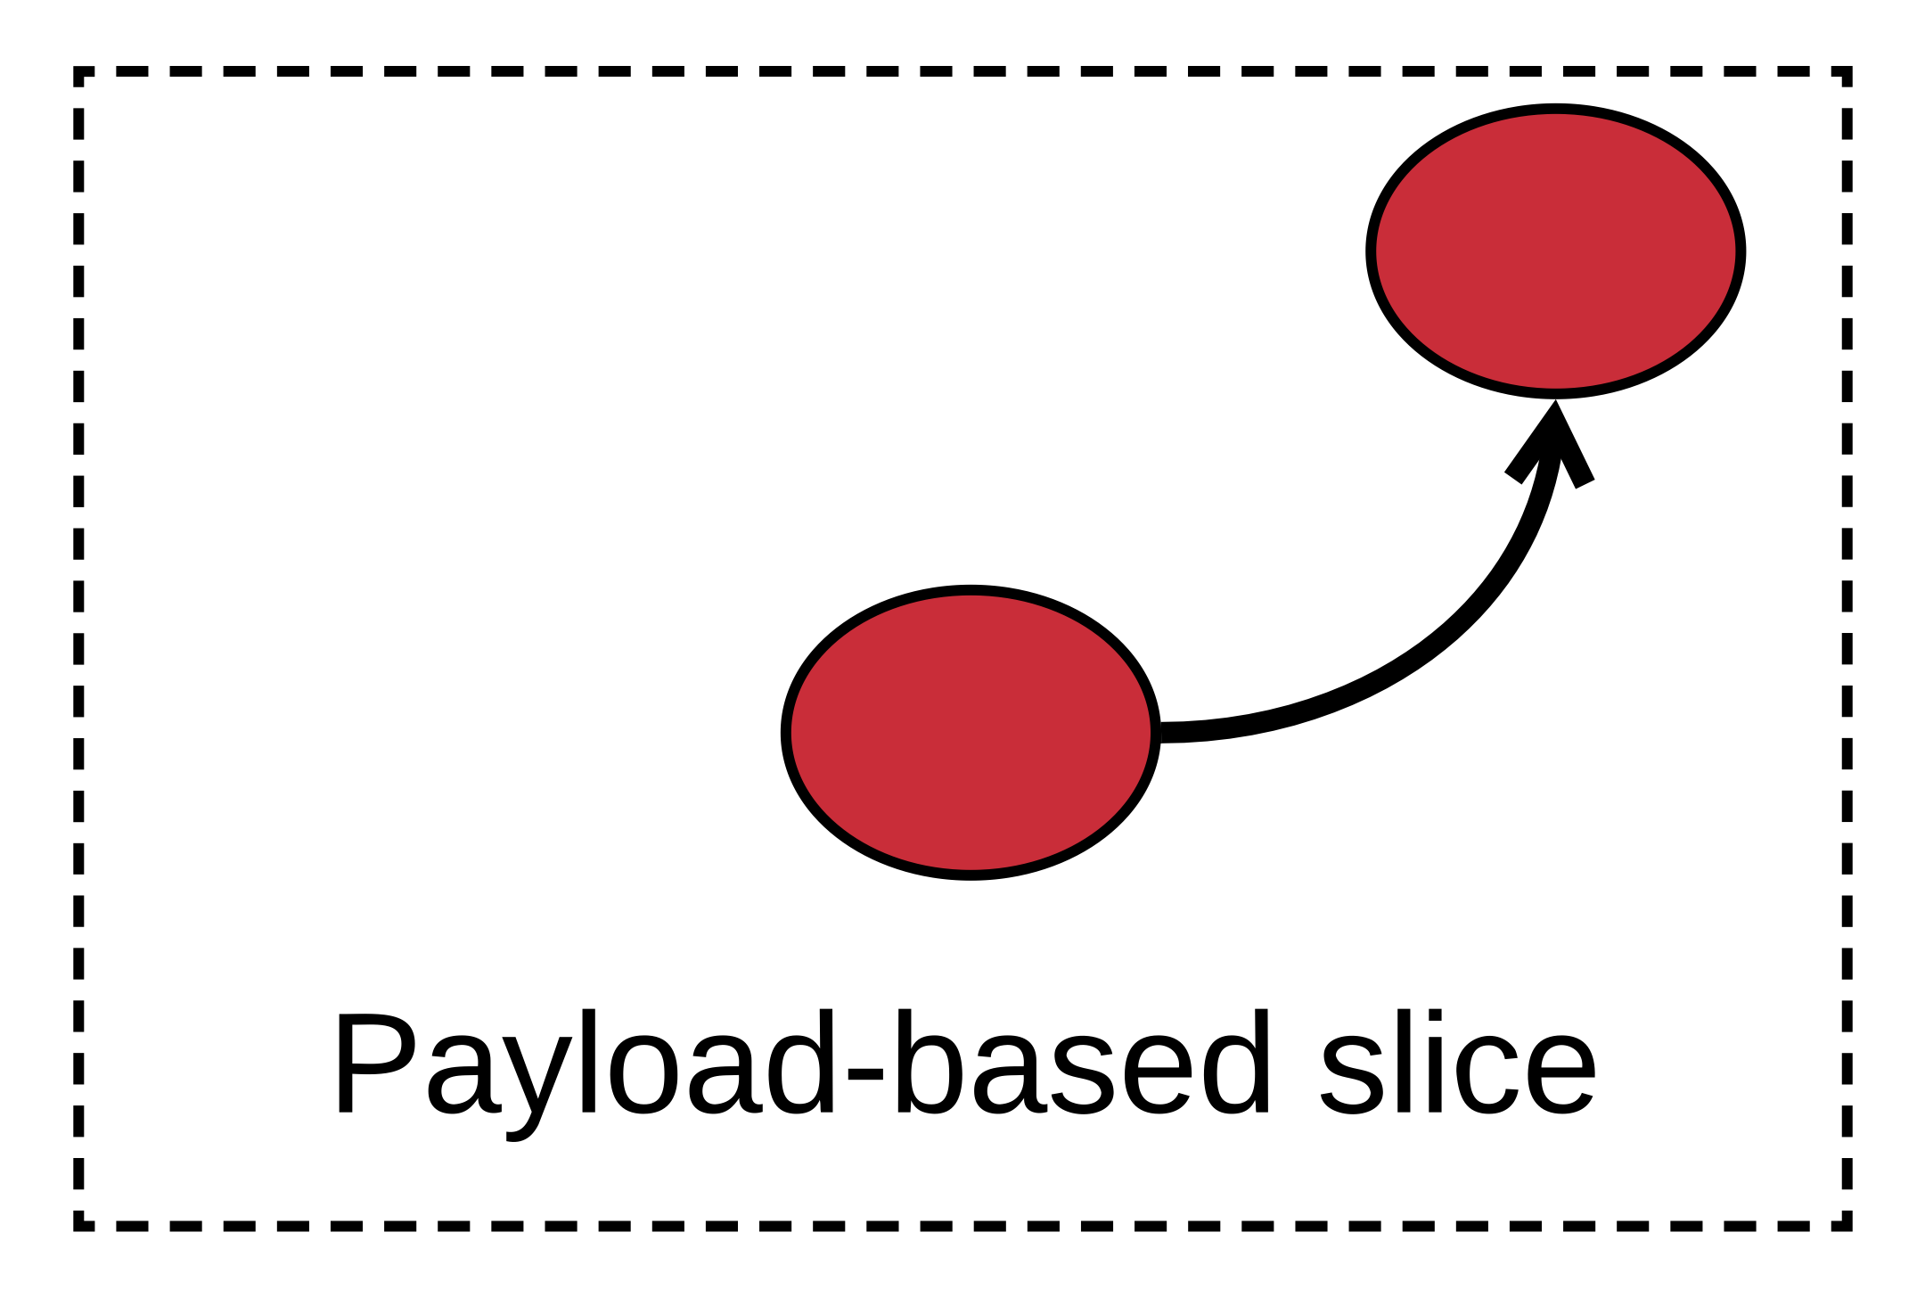
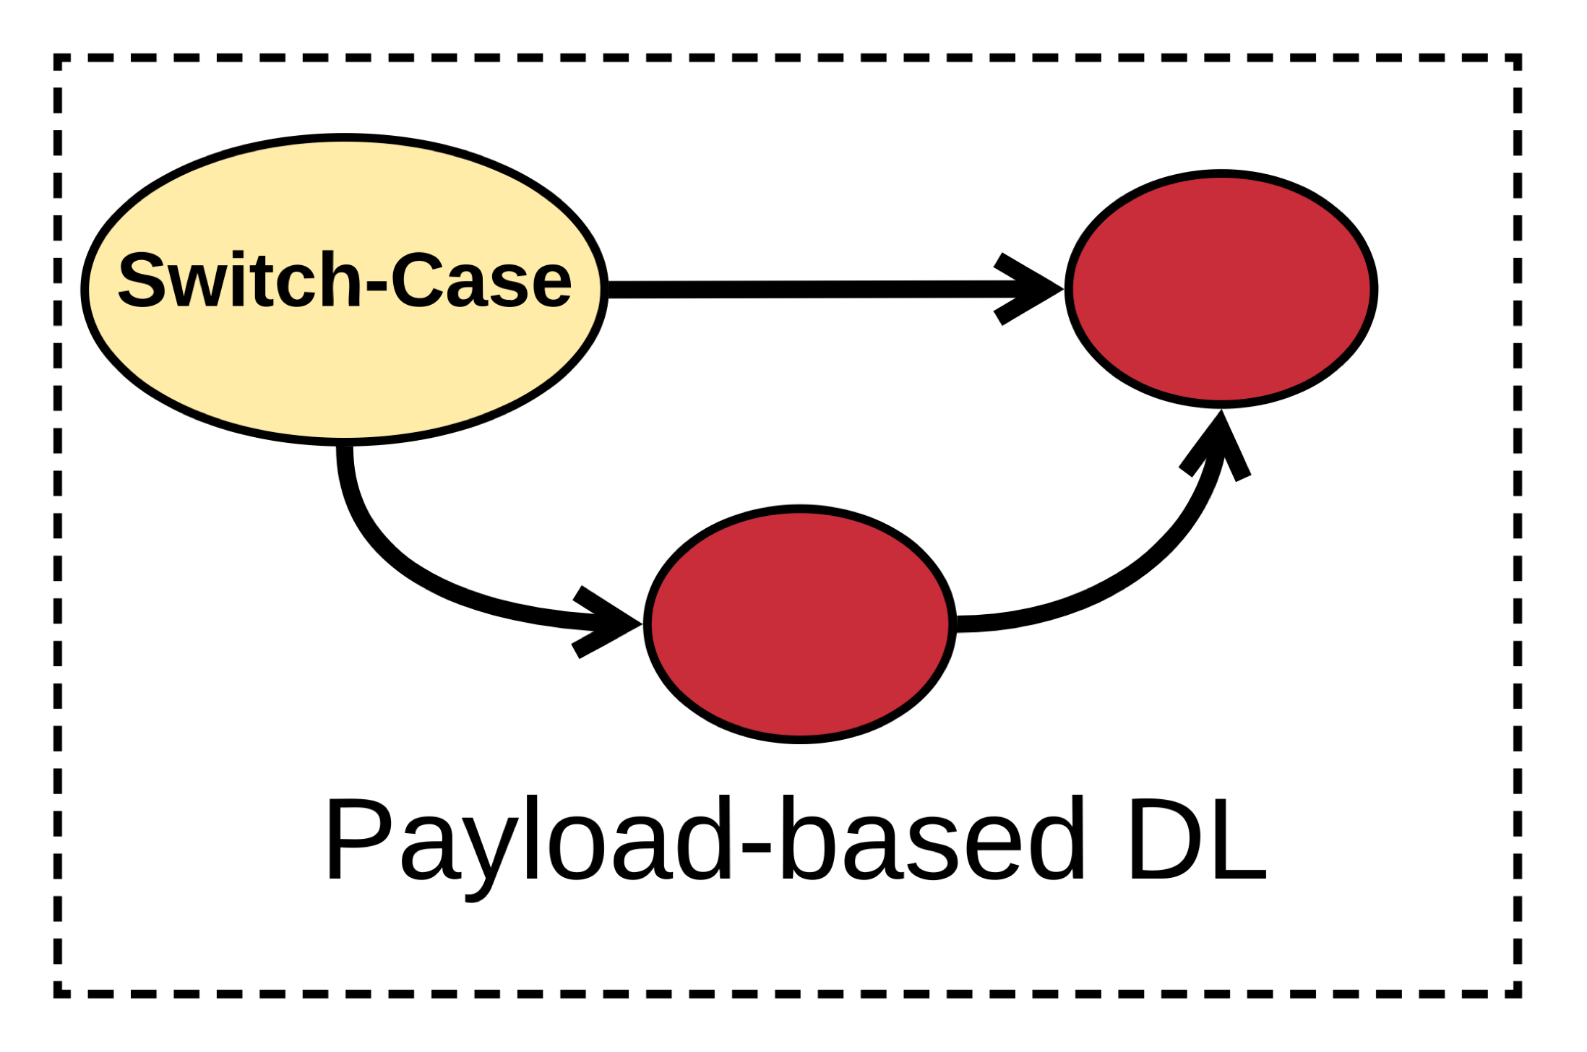
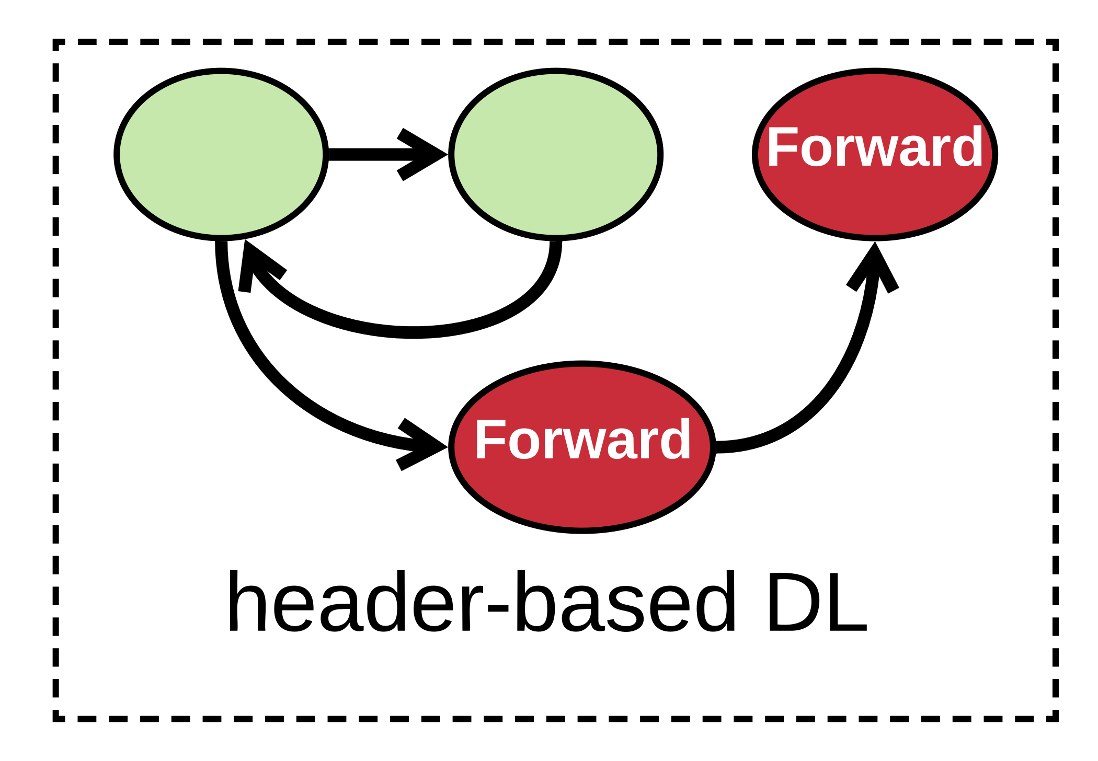
Detection Logic Program Partitioning
Detection Logic Program
1
2
4
3
Partitioned DLPs

Slide 26
Implementation & Evaluation
Implementation
  Xen hypervisor
  Frama-C framework for program analysis
  Click for microservices and DLPs
  RAMCloud for detection states sharing
Evaluation
  CloudLab
  Real-world dataset + generated attack traffic

Slide 27
Effectiveness of vNIDS
Malicious Activity Detection Rate (%)
Malicious Activity Detection Rate (%)
Malicious Activity Detection Rate (%)
CAIDA+Attack.trace
LBNL+Attack.trace
Campus+Attack.trace
* Detect all malicious activity: Bro, Share All, and vNIDS
* Miss malicious activities: No Share

Slide 28
Performance Improvements by Detection State Classification
> 50%
Packet Processing Time (microsecond)
Packet Processing Time Reduced (%)
* Reduced processing time: for all six detection logics
* Reduced rate: more than 50%

Slide 29
Efficiency of Microservices
Launch Time (millisec)
* Monolithic NIDS: launch slower
* Microservice: scale faster

Slide 30
Flexibility of vNIDS
Traditional NIDS
Instances
Internet
Rerouted Traffic
Site-1
(Clemson)
Site-2
(Wisconsin)
A
A
B
B
A
B
B
B
B

Slide 31
Flexibility of vNIDS
Virtualized NIDS
Instances
Internet
Rerouted Traffic
Site-1
(Clemson)
Site-2
(Wisconsin)
A
A
B
A
B
B

Slide 32
Flexibility of vNIDS
Virtualized NIDS
Instance-A
Virtualized NIDS
Instance-B
Internet
Communication Traffic
Site-1
(Clemson)
Site-2
(Wisconsin)
A
A
B
A
B
B

Slide 33
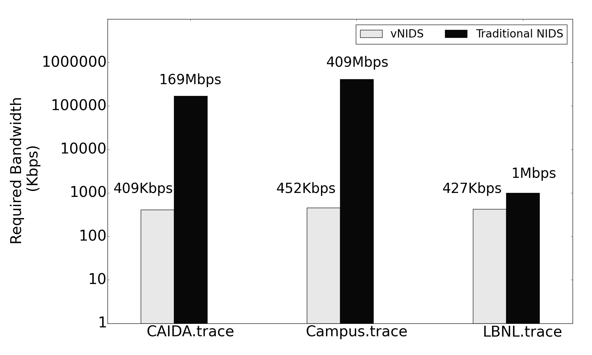
Flexibility of vNIDS
Reduce by 99.9% in the best case
Reduce by 58.3% in the worst case

Slide 34
Flexibility of vNIDS
Adjustable Capacity
Runtime throughput of vNIDS and Bro Cluster
Adjustable Resource Consumption
Number of instances of vNIDS and Bro Cluster

Slide 35
Conclusion and Future Work
Make a further step towards elastic security
  Safe and efficient NIDS virtualization
    Effective intrusion detection
    Non-monolithic NIDS provisioning
Implementation and Evaluation
  3 microservices & 6 detection logic programs
  Extensive Evaluation of vNIDS
Future work
  More fine-grained microservices
  Generalize our approach for other security and non-security NFs

Slide 36
Q & A
hongdal@clemson.edu
Clemson University

